Slide 1
CELL CYCLE AND CELL DIVISION

Slide 2
CELL CYCLE
The sequence of events by which a cell duplicates its genome, synthesizes other cell constituents, and eventually divides into two daughter cells is known as cell cycle.
The events of the cell cycle are under genetic control.
The cell cycle is the life cycle of a cell.
For eukaryotic cells, the cell cycle consists of two general phases : interphase and the mitotic phase.

Slide 3
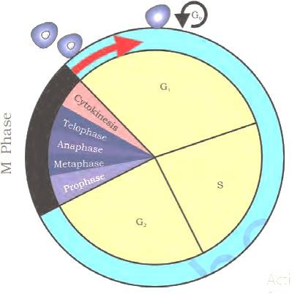
PHASES OF CELL CYCLE

Slide 4
Duration of the cell cycle varies from organism to organism, and from cell to cell.
in human- 24 hrs.
in yeast - 90 min.
Cell cycle consists of two phases :
  Interphase (Non-dividing phase)
  M-phase (Dividing phase)

Slide 5
G1 - phase
INTERPHASE
S- phase
G2 - phase
Cell Cycle
Prophase
Karyokinesis (Nuclear division)
Metaphase
Anaphase
Telophase
MITOTIC PHASE
Cytokinesis
(Cytoplasmic division)

Slide 6
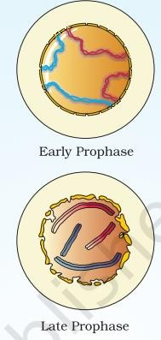
MITOSIS
Prophase:

Slide 7
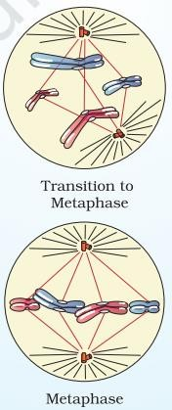
Meta phase:

Slide 8
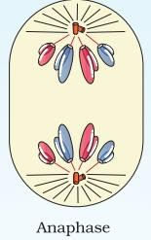
Ana phase:

Slide 9
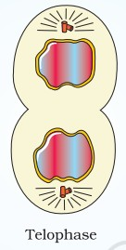
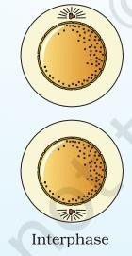
Telophase and Cytokinesis:

Slide 10
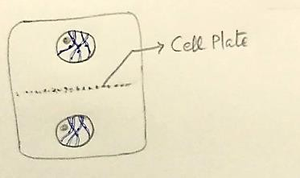
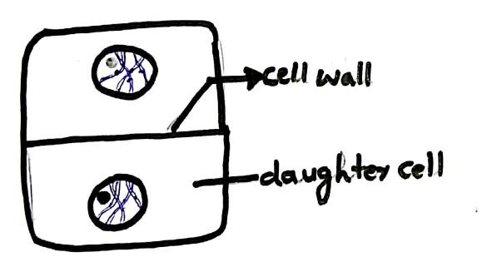
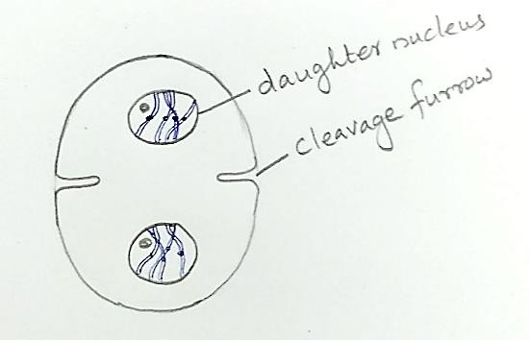
CYTOKINESIS IN PLANTS
CYTOKINESIS IN ANIMALS

Slide 11
SIGNIFICANCE OF MITOSIS
It produces diploid daughter cells with identical genome.
It helps to retain the same chromosome number in all somatic cells.
It helps in the body growth of multicellular organisms. Mitosis in the meristematic tissues helps in a continuous growth of plants throughout the life.
It restores the nucleo-cytoplasmic ratio that disturbed due to cell growth.
It helps in cell repair & replacement. E.g. cells of the upper layer of the epidermis, lining of the gut & blood cell.

Slide 12
MEIOSIS
Leptotene
Prophase I
Zygotene
Metaphase I
Karyokinesis
Diplotene
Division.I (meiosis. I)
(Nuclear Division)
Anaphase I
Diakinesis
Cytoplasmic division (Cytokinesis)
Telophase I
INTERKINESIS
Meiosis
Prophase II
Karyokinesis
Metaphase II
Division.II (Meiosis. II)
Anaphase II
Telophase II
Cytokinesis

Slide 13
Leptotene (Leptonema)
Fine threaded stage
bouquet stage
Synapsis
Bivalent formation
Zygotene (zygonema)
Tetrad stage condition
PROPHASE I
of Meiosis I
recombination nodule formation
Pachytene (pachynema)
recombination (crossing over) occur between non-sister chromates
cross overed regions called chiasmata occur as x shaped (cross-wise)
Diplotene (Diplonema)
Terminalization occur (chiasmata move towards the terminal part)
Diakinesis
N.M.& Nucleolus Disappear
spindle fibres start to appear.

Slide 14
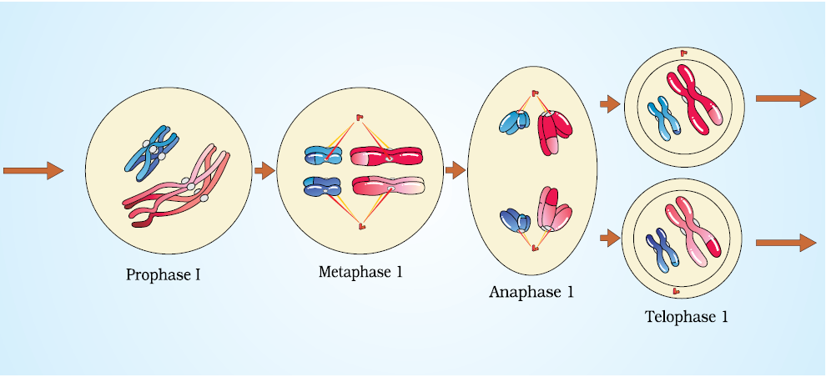

Slide 15
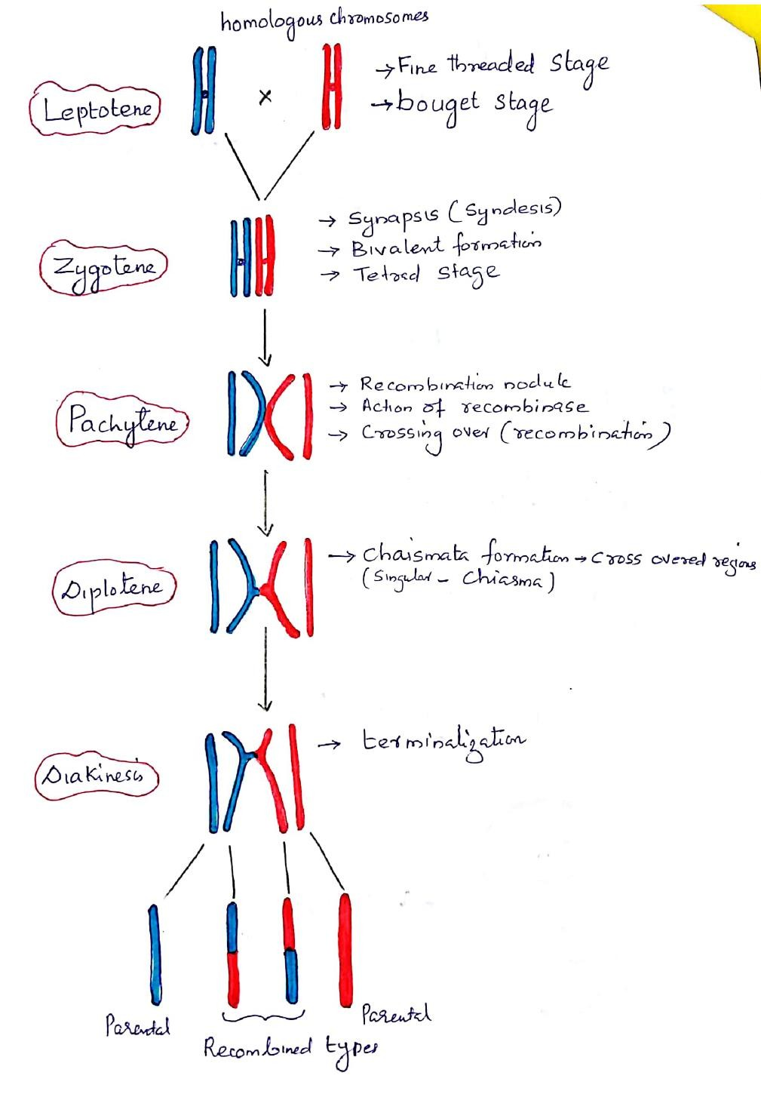

Slide 16
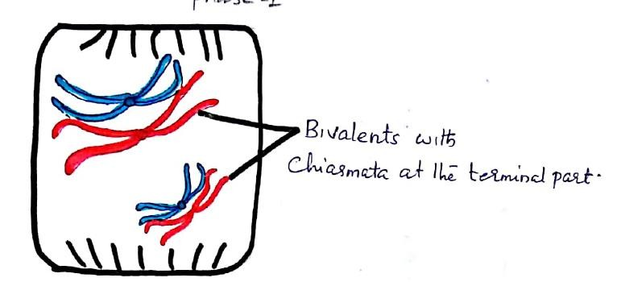
PROPHASE 1

Slide 17
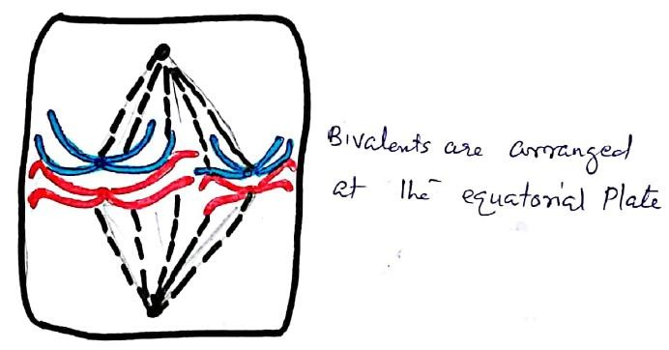
METAPHASE 1

Slide 18
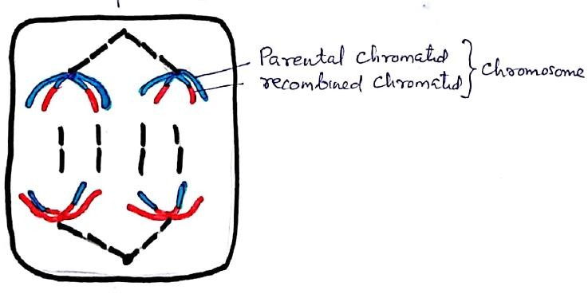
ANAPHASE 1

Slide 19
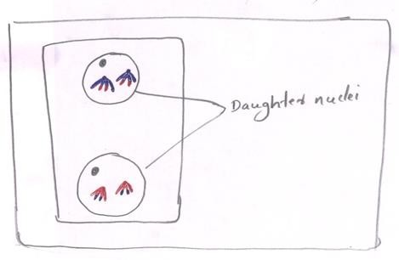
TELOPHASE 1 [Diad of cells]

Slide 20
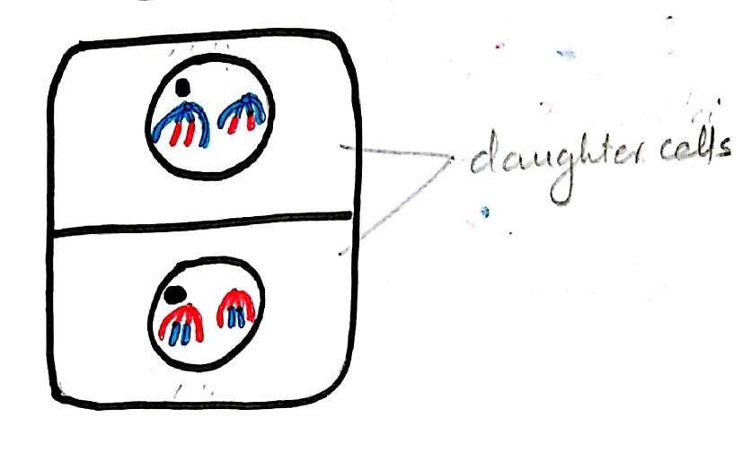
CYTOKINESIS

Slide 21
MEIOSIS II
PROPHASE-II

Slide 22
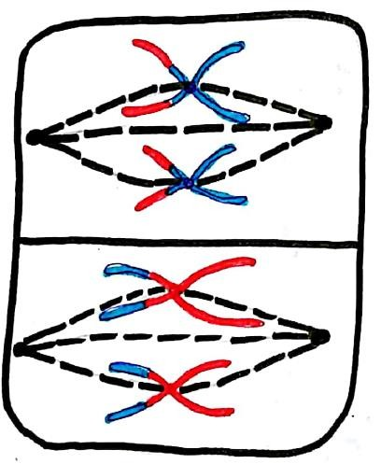
METAPHASE II

Slide 23
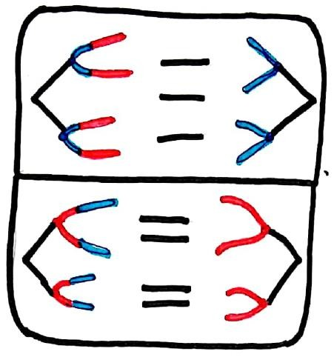
ANAPHASE II

Slide 24
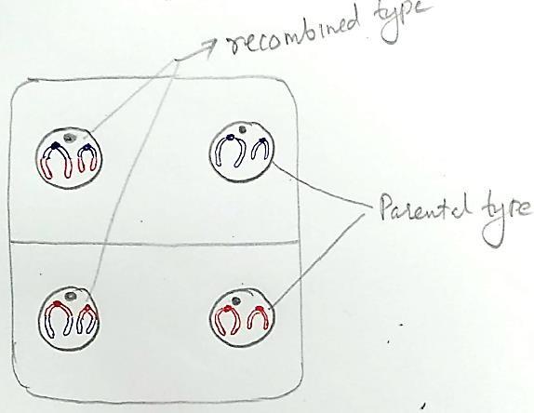
TELOPHASE II (Tetrad of Cells)

Slide 25
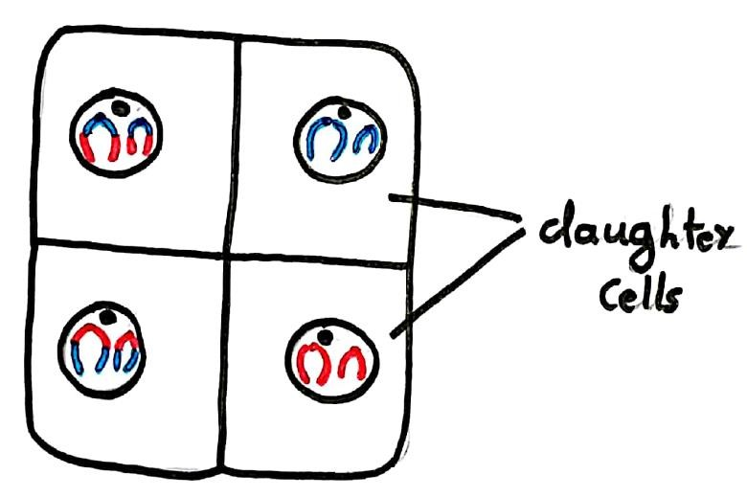
CYTOKINESIS

Slide 26
SIGNIFICANCE OF MEIOSIS
Meiosis maintains the chromosome number from generation to generation.
It reduces the chromosome number to half so that the process of fertilisation restores the original number in the zygote.
Meiosis occurs during gamete formation (gametogenesis) and reduces the number of chromosomes from diploid (2n) to haloid (n) in the gametes.
These haploid gametes fuse to form diploid zygote during fertilization. The diploid zygote develops into a normal diploid individual.
Variations are caused by the crossing over leads to the random distribution of homologous chromosomes between daughter cells.
Variations play an important role in evolution.

Slide 27
Class Assignment
1. Proteins and new cell organelles are synthesised during
1. Post-mitotic phase 2. Pre-mitotic phase
3. The phase present at the end of G₁ and the beginning of G₂
4. M-phase
2. Synthesis of proteins occurs during:
1. G₁ 2. G₂ 3. S 4. All the above
3. Which stage of cell cycle is characterised by DNA-replication,
synthesis of Histones and formation of new nucleosomes
1. S-phase 2. G₁-phase 3. G₂-phase 4. M-phase

Slide 28
4. Replication of centriole occurs during
1. Interphase 2. Prophase
3. Late prophase 4. Late telophase
5. In which stage of cell division the chromosomes are most condensed:
1. Prophase 2. Metaphase 3. Anaphase 4. Telophase
6. During cell division, chromosome attaches with spindle’s
1. Kinetochore 2. Centrosome
3. Centriole 4. Secondary constriction

Slide 29
7. During meiosis
1. Nucleus, chromosomes divides one, cytoplasm divides once or twice
2. Nucleus, chromosomes and centromere divides once
3. Nucleus divides twice, chromosomes divide one and cytoplasm divides twice
4. Nucleus, chromosomes and Centromere divides twice and cytoplasm divides once
8. Arrange the following events of meiosis in a correct sequence
(I) Division of centromere (II) Segregation of chromosomes
(III) Terminalization (IV) Appearance of chromomeres
1. II, III, IV, I 2. II, III, I, IV 3. IV, III, II, I 4. IV, II, III, I

Slide 30
9. Homologous chromosomes show maximum attraction during
1. Leptotene 2. Zygotene 3. Pachytene 4. Diplotene
10. The sequence of events by which cells duplicate their genome synthesize the other components of cell which eventually distribute into two daughter cells is called
1. Quiescent stage 2. Generation time
3. Cell cycle 4. Kinetochore
11. What happens in synthesis phase during cell cycle?
1. DNA synthesis
2. Chromosome number becomes double
3. Formation of two nuclei
4. Synthesis of tubulin proteins

Slide 31
12. If the initial amount of DNA is 8 C, then after S phase the amount of DNA would be
1. 4 C 2.8 C 3. 64 C 4. 16 C
13. In a slow dividing normal cell:
1. G₁ phase is longer than S phase
2. S phase is longer than G₁ phase
3. Both phases are equal in duration
4. Can’t be determined
14. Which type of chromosome is present in the prophase of cell cycle?
1. 2 Chromatid 2. 1 Chromatid
3. 4 Chromatid 4. 8 Chromatid

Slide 32
15. Mitotic spindle initiates during
1. Telophase 2. Anaphase 3. Prophase 4. Metaphase
16. In which stage of meiosis, chromosomes are thin, long thread like?
1. Zygotene 2. Leptotene 3. Pachytene 4. Diakinesis
17. Meiosis involves:
1. One nuclear division and one chromosome division
2. Two nuclear divisions and one chromosome division
3. One nuclear division and two chromosome divisions
4. Two nuclear division and two chromosome divisions

Slide 33
18. After meiosis-I, the two chromatids of a chromosome are
1. Genetically similar 2. Genetically different
3. There occurs only one chromatid in each chromosome
4. None of the above
19. Pairing of homologous chromosomes is called:
1. Disjunction 2. Synaptosome 3. Segregation 4. Polytony
20. A cell examined during prophase of cell cycle contained 100 units of DNA and 50 chromosomes. What would be the number of DNA and chromosomes in anaphase of this cell cycle?
1. 200 DNA & 100 chromosomes 2. 100 DNA & 50 chromosomes
3. 100 DNA & 100 Chromosomes 4. 50 DNA & 25 chromosomes

Slide 34
21. What is not true about cell cycle?
a. During G₁ phase there is active synthesis of RNA and proteins but no change in its DNA content
b. In synthesis or S phase, each chromosome carries a duplicate set of genes
c. During G₂ phase, a cell contains double the amount (4C) of DNA present in the original diploid cell (2C)
d. In S-phase a cell doubles the original diploid (2n) chromosome number
1. c & d 2. b &c 3. d only 4. b, c, & d
22. A cell cycle includes.
1. Interphase and M phase
2. Prophase, Metaphase, anaphase and telophase
3. G₁, S and G₂ phases 4. Karyokinesis and cytokinesis

Slide 35
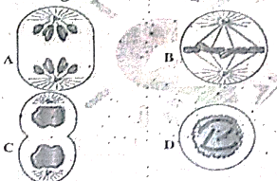
23. Following are the various stages of mitosis (A-D)
Which of the following is the correct sequency of their occurrence?
1. D → B → A → C 2. D → A → B → C
3. A → B → D → C 4. C → A → B → D

Slide 36
24. Read the given events occurring in a cell cycle and answer the question following them.
i. Movement of centrioles towards the opposite poles
ii. Disappearance of nucleolus and nuclear membrane
iii. Alignment of chromosomes at equator
iv. Decondensation of chromosomes to chromatin material
1. 2 → 1 → 3 → 5 → 4 2. 2 → 1 → 5 → 4 → 3
3. 1 → 2 → 5 → 4 → 3 4. 4 → 2 → 1 → 3 → 5

Slide 37
25. Meiosis consists of
1. Two cell divisions without any DNA replication
2. Two cell divisions in which chromosome number is reduced to half
3. Two cell divisions with only two rounds of chromosome replication
4. A single cell division with chromosome replication.
26. Crossing over is the exchange of genetic material between the
1. Non-sister chromatids of non-homologous chromosomes
2. Sister chromatids of non-homologous chromosomes
3. Non-sister chromatids of homologous chromosomes
4. Sister chromatids of chromosomes

Slide 38
27. Genetic variability in sexually reproducing organisms is due to_______
1. Amitosis 2. Multiple fission
3. Mitosis 4. Meiosis
28. In meiosis during prophase-I, recombination nodules are observed during
1. Zygotene 2. Diakinesis
3. Diplotene 4. Pachytene

Slide 39
29. Which of the following stage of meiosis is not correctly matched with the event given?
Stage |  | Event
1. | Diplotene | Terminalization of chiasmata
2. | Metaphase -II | Alignment of chromosomes at the equator
3. | Zygotene | Formation of tetrad
4. | Anaphase-I | Separation of homologous chromosomes

Slide 40
ASSERTION AND REASON:
In the following questions, a statement of assertion is followed by a statement of reason, Mark the correct choice as:
1. If both assertion and reason are true and reason is the correct explanation of assertion
2. If both assertion and reason are true but reason is not the correct explanation of assertion
3. If assertion is true but reason is false.
4. If assertion is false but reason is true

Slide 41
30. Assertion: Meiotic division occurs in reproductive cells
Reason: As a result of meiosis, gametes are formed
31. Assertion: The stage between the two meiotic divisions is called interkinesis and is generally short lived
Reason: In meiosis, prophase II is much complex than prophase L.
Statement based question:
Read the following statements and select the correct option
1. Both Statement-I and Statement-II are correct
2. Statement-I is correct but Statement -II is incorrect
3. Statement-I is incorrect but Statement-II is correct
4. Both Statement-I and Statement-II are incorrect

Slide 42
32. Read the following statements and select the correct option
Statement-I: Mitosis usually results in the production of diploid daughter cells with identical genetic complement.
Statement-II: Mitotic divisions in the underestimate tissues the apical and the lateral cambium, result in a continuous growth of plants throughout their life
33. Statement I: During S phase, chromosome number per cell doubles
Statement II: During S phase, centriole duplicate in the nucleoplasm

Slide 43
34. Statement I: Metaphase is characterized by metaphase plate
Statement II: Anaphase is characterized by decondensation of chromosomes
35. Statement-I: Interphase represents the phase between two successive M phases
Statement II: The mitosis phase is also called resting phase

Slide 44
36. Match column I with column II and select the correct option from the codes given below:
 | Column I | Column II
A. | G₁₋Phase | 1. | Cell grows and organelle duplication
B. | S-phase | 2. | DNA replication and
C. | G2-phase | 3. | Cytoplasmic growth
D. | Metaphase in M-phase chromosome duplication | 4. | Alignment of chromosomes
Codes:
A B C D
1. 2 3 4 1
2. 3 4 1 2
3. 4 1 2 3
4. 1 2 3 4

Slide 45
37. The process of appearance of recombination nodules occurs at which sub stage of prophase I in meiosis?
1. Pachytene 2. Diplotene
3. Diakinesis 4. Zygotene
38. Which of the following stages of meiosis involves division of centromere?
1. Metaphase II 2. Anaphase II
3. Telophase 4. Metaphase I
39. Among eukaryotes, replication of DNA taken place in
1. S phase 2. G₁ phase 3. G₂ phase 4. M phase

Slide 46
40. Match List I with List II
List I List II
A. M phase I. Proteins are synthesized
B. G₂ phase II. Inactive phase
C. Quiescent stage III. Interval between mitosis and Initiation of DNA replication
D. G₁ phase IV. Equational division
Choose the correct answer the from the options given below:
1. A-IV, B-II, C-I, D-III 2. A-IV, B-I, C-II, D-III
3. A-II, B-IV, C-I, D-III 4. A-III, B-II, C-IV, D-I

Slide 47




